Slide 1
Hospital Management System (Mini - Project)
By – Darsh Jotangia

Slide 2
Hospital-management-system
The Project uses:
Springboot
Maven
MongoDB
Swagger
Junit
Docker
GitHub
Postman

Slide 3
Dependencies
Dependencies used are:
spring-boot-starter-web
springdoc-openapi-ui
Junit
spring-boot-starter-test
spring-boot-starter-security
spring-security-test
spring-boot-starter-data-mongodb
commons-io

Slide 4
Architecture
The microservice has 3 controllers , DoctorController, PatientController and PrescriptionController.
These controllers communicate with 2 repositories namely AppointmentRepository and PrescriptionRepository.
The repositories further use Models - Appointment and Prescription to store data in MongoDB Database.

Slide 5
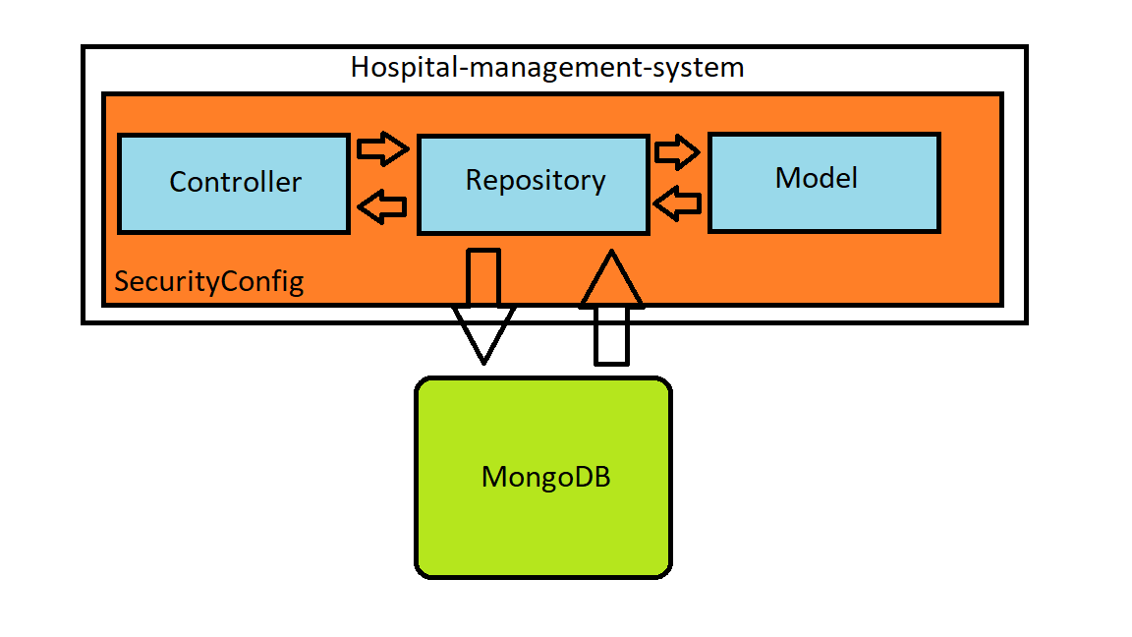
Architecture

Slide 6
Data Model / Classes used
Two classes were used , which are:
Appointment
Prescription

Slide 7
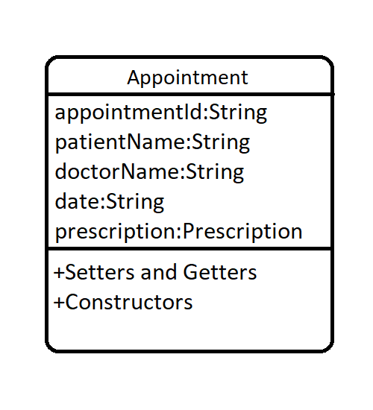
Appointment - Class
Attributes:
appointmentId
patientName
doctorName
date
prescription

Slide 8
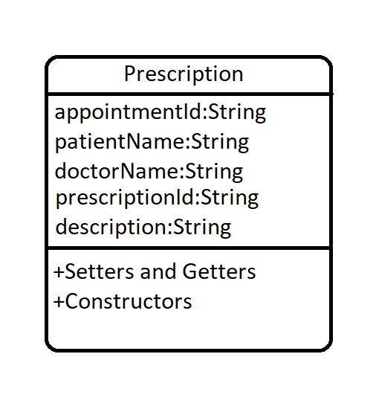
Prescription - Class
Attributes:
prescriptionId
appointmentId
description
patientName
doctorName

Slide 9
Repository
This projects uses 2 repositories , AppointmentRepository and PrescriptionRepository.
Each repository extends MongoRepository which provides all the necessary methods which help to create CRUD application.

Slide 10
Controllers
In total 3 controllers were used, namely:
DoctorController
PatientController
PrescriptionController
Each controller has role-based access restriction, based on the SecurityConfig.java file.
DoctorController can be accessed by doctors only, similarly PatientController can be accessed by patients only and PrescriptionController can be accessed by users of both roles.

Slide 11
DoctorController
DoctorController is mapped with “/doctor” and has the following end points:
“/doctorappointment” - which will receive GET requests along with request parameters. For ex-” http://localhost:8081/doctor/doctorappointment?doctorName=doctor1”.
“/save” – which will receive POST requests along with Appointment object in JSON format as body.For ex – “http://localhost:8081/doctor/save” .

Slide 12
PatientController
PatientController is mapped with “/patient” and has the following end points:
“/myappointment” - which will receive GET requests along with request parameters. For ex-” http://localhost:8081/patient/patientappointment?patientName=patient1”.
“/save” – which will receive POST requests along with Appointment object in JSON format as body.For ex – “http://localhost:8081/patient/save” .

Slide 13
PrescriptionController
PrescriptionController has the following end points:
“/viewprescription” - which will receive GET requests along with request parameters. For ex-” http://localhost:8081/saveprescription?patientName=patient1”.
“/saveprescription” – which will receive POST requests along with Prescription object in JSON format as body.For ex – “http://localhost:8081/saveprescription” .

Slide 14
Security
Configuration for security was added allowing only authorized users with appropriate roles to have access.
WebSecurityConfigerAdapter is extended and roles to endpoints and users were created.
The Roles are as follows:
DOCTOR - doctor1 PASSWORD - password
PATIENT - patient1 PASSWORD - password
DOCTOR,PATIENT - user1 PASSWORD - password

Slide 15
Testing and Code Coverage
Test Cases were made for each mapping using Mockito and Junit and with code coverage:
Classes - 100%
Methods - 93%
Lines - 88%

Slide 16
Documentation
Swagger is used for interactive API documentation of the microservice and its architecture.
It involves description of the classes and mappings used in the controllers along with execution and response monitoring of the mappings.

Slide 17
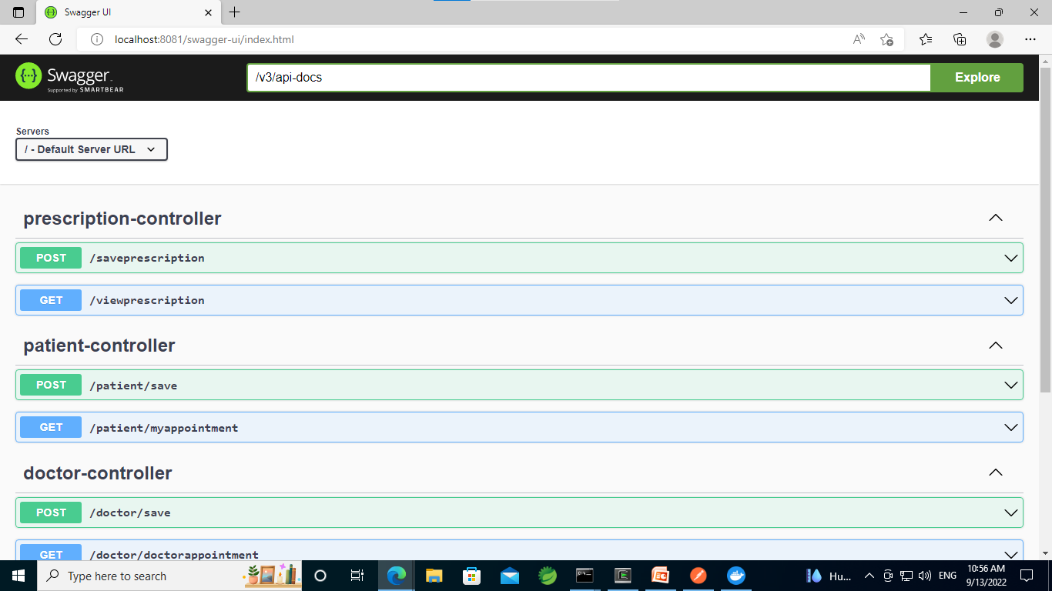
Swagger Screenshot

Slide 18
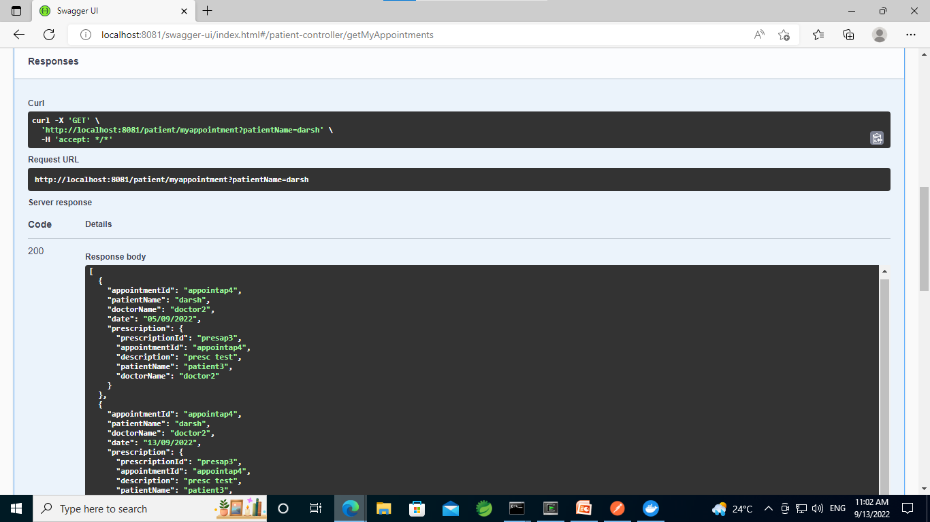
Swagger Screenshot

Slide 19
Dockerization
Dockerization is the process of packing, deploying and running applications using Docker containers. Docker is a tool that ships the application with all the necessary functionalities as one package.
This is acheived by making a docker image of our springboot appplication and then by the help of docker compose, we run our containers(i.e. Application container and MongoDB container) on the same network.

Slide 20
Postman
Postman makes it easier to create, share, test and document APIs. With this we can create and save simple and complex HTTP/s requests and their responses.
We have also used the curl commands generated from Postman to test the functionality of the project through command line tools such as Cygwin and Command Prompt.

Slide 21
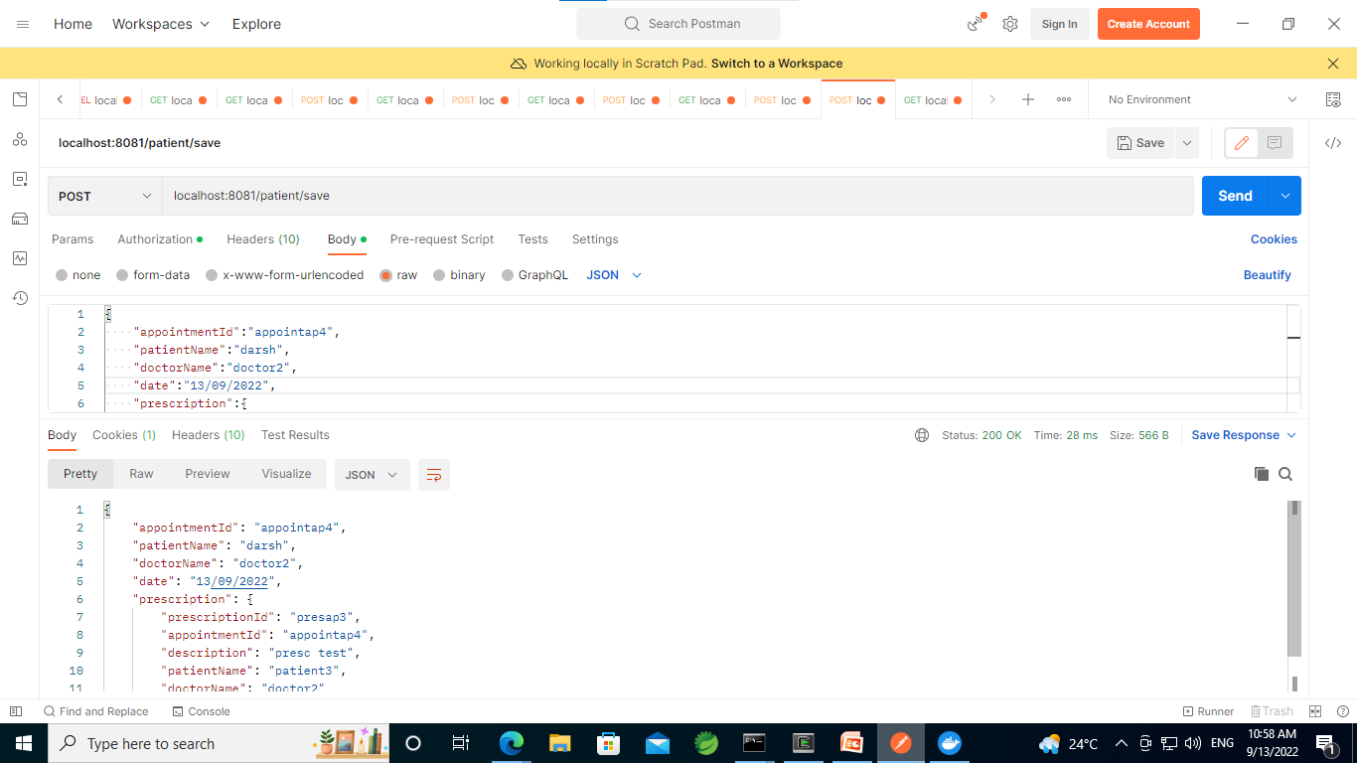
Postman Screenshot - POST

Slide 22
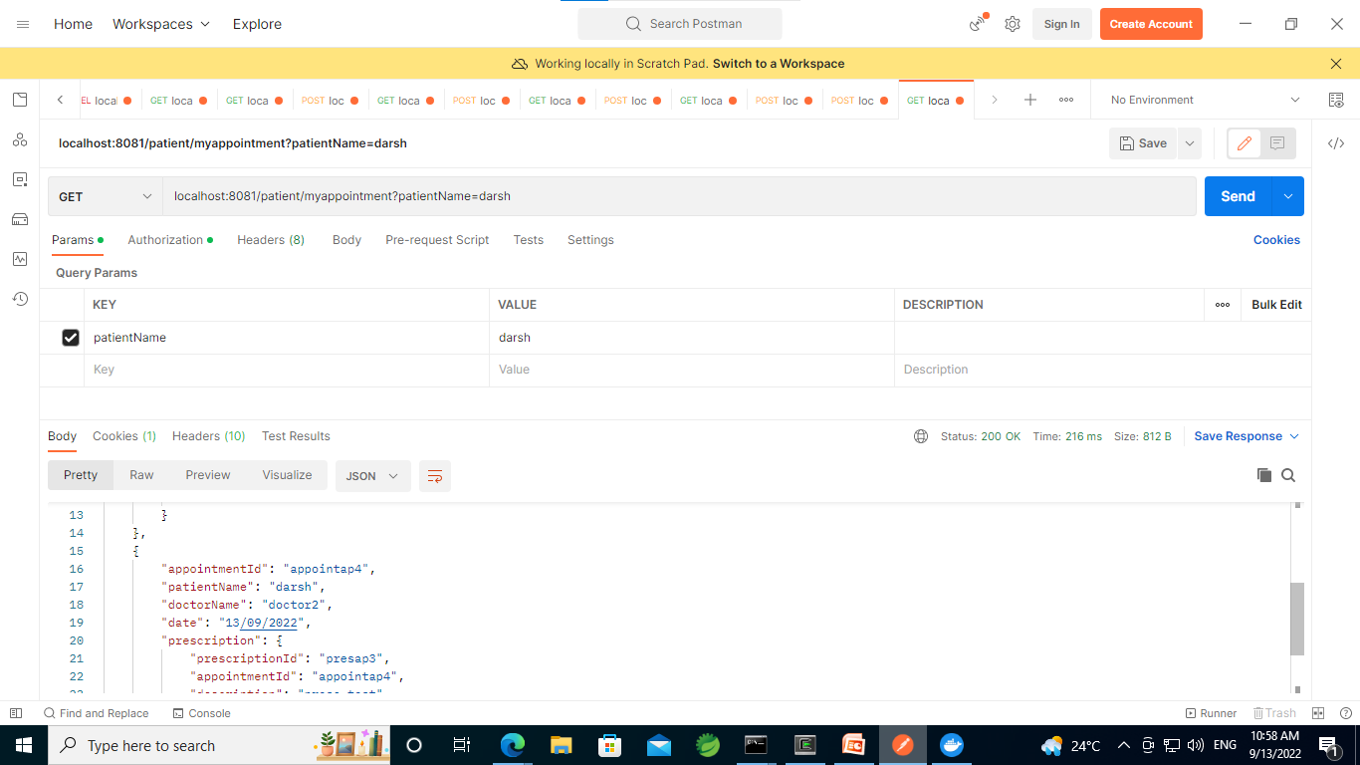
Postman Screenshot - GET

Slide 23
Thank You

